Slide 1
Servlets

Slide 2
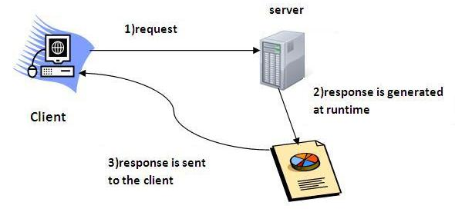
Servlets
Java Servlets are programs that run on a Web or Application server and act as a middle layer between a requests coming from a Web browser or other HTTP client and databases or applications on the HTTP server.
Servlet is a web component that is deployed on the server to create dynamic web page.

Slide 3
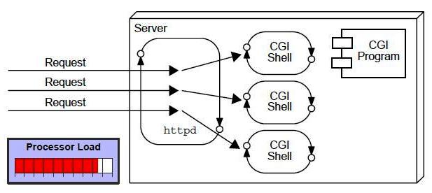
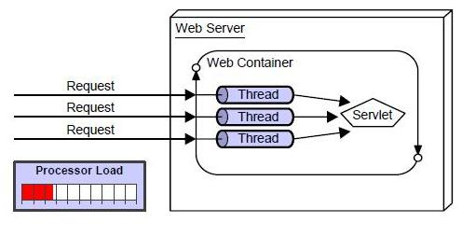
Servlet vs CGI(Common gateway Interface)

Slide 4
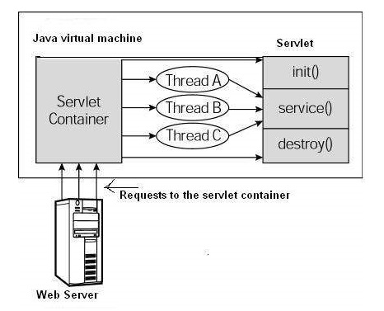
Servlet Life Cycle

Slide 5
Servlet Life Cycle
The init() Method
The init method is called only once. It is called only when the servlet is created, and not called for any user requests afterwards.
public void init() throws ServletException { // Initialization code... }
The service() Method
The servlet container (i.e. web server) calls the service() method to handle requests coming from the client( browsers) and to write the formatted response back to the client.
The service() method checks the HTTP request type (GET, POST, PUT, DELETE, etc.) and calls doGet, doPost, doPut, doDelete, etc. methods as appropriate.
public void service(ServletRequest request, ServletResponse response) throws ServletException, IOException { }

Slide 6
Servlet Life Cycle
The destroy() Method
The destroy() method is called only once at the end of the life cycle of a servlet. This method gives your servlet a chance to close database connections, halt background threads, write cookie lists or hit counts to disk, and perform other such cleanup activities.
public void destroy() { // Finalization code... }

Slide 7
Servlet API
The javax.servlet and javax.servlet.http packages represent interfaces and classes for servlet api.
Interfaces in javax.servlet package | Classes in javax.servlet package
1. Servlet | 1. enericServlet
2. ServletRequest | 2. ServletInputStream
3. ServletResponse | 3. ServletOutputStream
4. RequestDispatcher | 4. ServletRequestWrapper
5. ServletConfig | 5. ServletResponseWrapper
6. ServletContext | 6. ServletRequestEvent
7. SingleThreadModel | 7. ServletContextEvent
8. Filter | 8. ServletRequestAttributeEvent
9. FilterConfig | 9. ServletContextAttributeEvent
10. FilterChain | 10. ServletException
11. ServletRequestListener | 11. UnavailableException
12. ServletRequestAttributeListener
13. ServletContextListener
14. ServletContextAttributeListener

Slide 8
javax.servlet.http
Interfaces in javax.servlet.http package | Classes in javax.servlet.http package
1. HttpServletRequest | 1. HttpServlet
2. HttpServletResponse | 2. Cookie
3. HttpSession | 3. HttpServletRequestWrapper
4. HttpSessionListener | 4. HttpServletResponseWrapper
5. HttpSessionAttributeListener | 5. HttpSessionEvent
6. HttpSessionBindingListener | 6. HttpSessionBindingEvent
7. HttpSessionActivationListener | 7. HttpUtils (deprecated now)
8. HttpSessionContext (deprecated now)

Slide 9
Servlet creation
The servlet example can be created by three ways:
By implementing Servlet interface,
By inheriting GenericServlet class, (or)
By inheriting HttpServlet class

Slide 10
Example servlet (init method)
import java.io.*; import javax.servlet.*;import javax.servlet.http.*;
public class HelloWorld extends HttpServlet {
private String message;
public void init() throws ServletException {
message = "Hello World";
}

Slide 11
Example servlet (sevice/processRequest)
protected void processRequest(HttpServletRequest request, HttpServletResponse response)
throws ServletException, IOException {
response.setContentType("text/html;charset=UTF-8");
try (PrintWriter out = response.getWriter()) {
/* TODO output your page here. You may use following sample code. */
out.println("<!DOCTYPE html>");
out.println("<html>");
out.println("<head>");
//out.println("<title>Servlet HelloWorld</title>");
out.println("</head>");
out.println("<body>");
out.println("<h1>Servlet at " + message + "</h1>");
out.println("</body>");
out.println("</html>");
}
}

Slide 12
Example servlet (destroy)
public void destroy() {
// do nothing.
}
}

Slide 13
Servlet Form
GET Method
The GET method sends the encoded user information appended to the page request. The page and the encoded information are separated by the ?(question mark) symbol as follows −
http://www.test.com/hello?key1 = value1&key2 = value2
http://localhost:8080/HelloForm?first_name = VIT&last_name = UNIV
http://localhost:8080/WebApplication1/HelloForm1?first_name=VIT&last_name=UNIV

Slide 14
Servlet form program
out.println(docType +
"<html>\n" +
"<head><title>" + title + "</title></head>\n" +
"<body bgcolor = \"#f0f0f0\">\n" +
"<h1 align = \"center\">" + title + "</h1>\n" +
"<ul>\n" +
" <li><b>First Name</b>: "
+ request.getParameter("first_name") + "\n" +
" <li><b>Last Name</b>: "
+ request.getParameter("last_name") + "\n" +
"</ul>\n" +
"</body>
</html>"
);
}
}
import java.io.*;
import javax.servlet.*;
import javax.servlet.http.*;
public class HelloForm extends HttpServlet {
protected void processRequest(HttpServletRequest request, HttpServletResponse response)
throws ServletException, IOException {
response.setContentType("text/html;charset=UTF-8");
try (PrintWriter out = response.getWriter()) {
String title = "Using GET Method to Read Form Data";
String docType =
"<!doctype html public
\"-//w3c//dtd html 4.0 " + "transitional//en\">\n";

